Slide 1

HR ANALYTICS

Slide 2
ASSOCIATES :
Mr. Bhairav Kishor Rane
Mr. Tejas Ghansham Kale
Mr. Gaurav D. Thakare
Ms. Dasari Krishna Teja Sree
Mr. Aftab Ali Akhtar Ali Shaikh
Mr. Muhammed Shafeek K
Mentor Name:
Ms. Dipti Sinha

Slide 3
CONTENTS :
Why HR Analytics ?
Metrics
KPI’s
Excel Dashboard
Power Bi Dashboard
Tableau Dashboard
Conclusion

Slide 4
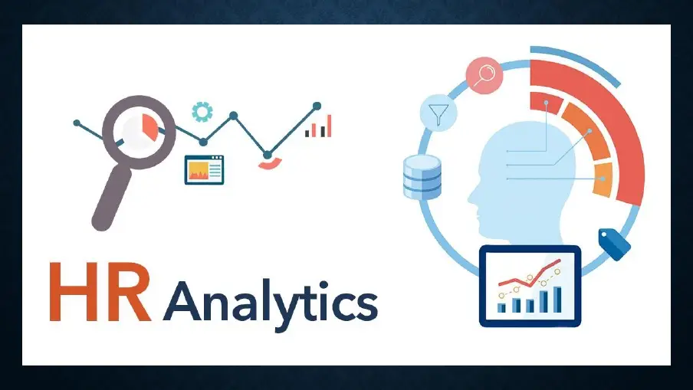
Why HR Analytics ?
HR Analytics is the science of gathering, organizing and analyzing the data related to HR functions like recruitment, talent management, employee management, performance and retention to ensure better decision making in all these areas.

Slide 5
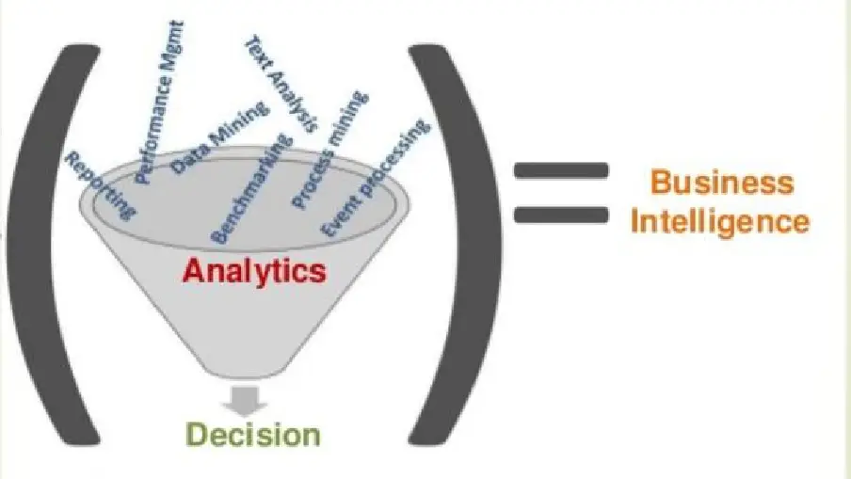
METRICS :
Human Resource (HR) metrics are measurements used to determine the value and effectiveness of HR initiatives, typically including such areas as turnover, training, return on human capital, costs of labor, and expenses per employee.

Slide 6
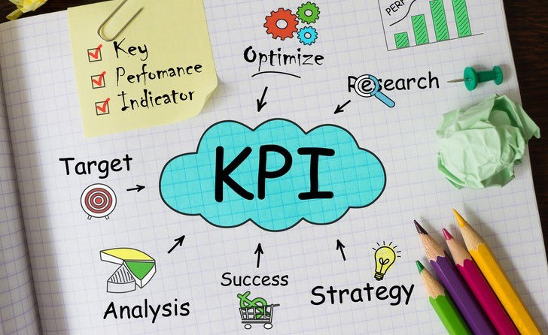
KPI’s
Average Attrition Rate for all Departments
Average Hourly Rate of Male Research Scientist
Attrition Rate vs Monthly Income Stats
Average Working Years for Each Department
Job Role vs Work Life Balance
Attrition Rate vs Year Since Last Promotion Relation

Slide 7
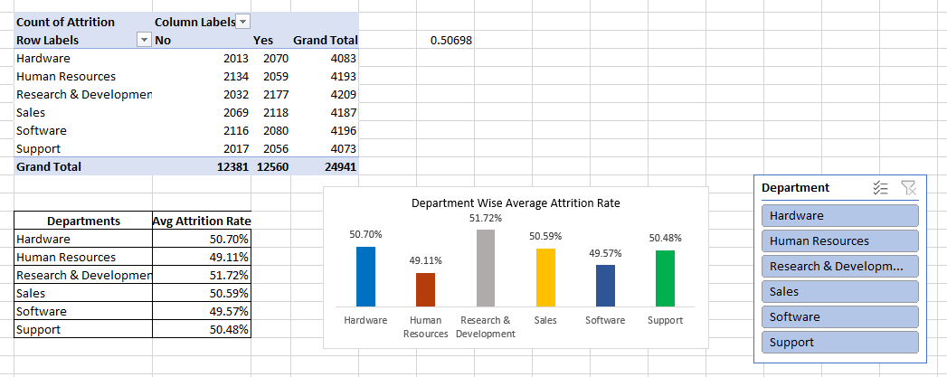
1. Average Attrition Rate for all Departments
The "Average Attrition Rate for all Departments" refers to the percentage of employees leaving a company across all its departments, averaged out. It provides a measure of how many employees are leaving the organization relative to the total workforce, offering insight into overall turnover trends within the company. A higher attrition rate may indicate dissatisfaction or issues within the organization, while a lower rate may suggest stability and satisfaction among employees.

Slide 8
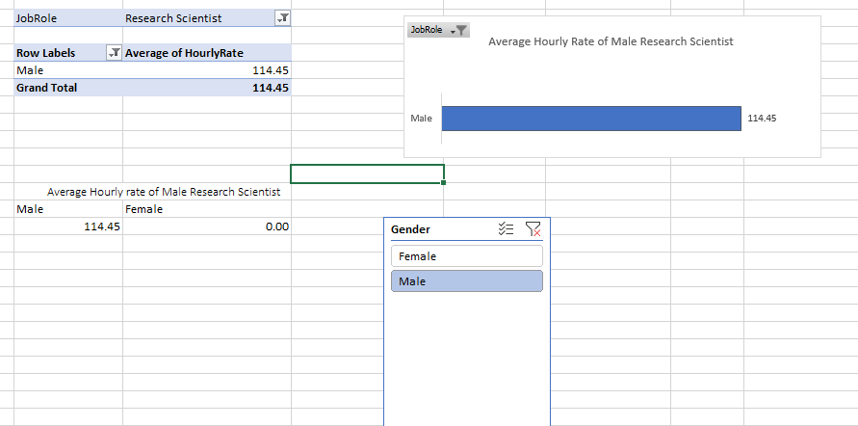
2. Average Hourly Rate of Male Research Scientist
The "Average Hourly Rate of Male Research Scientists" is the average amount paid per hour to male employees working in the role of research scientist within a specific organization or industry. It provides a metric for understanding the compensation level for this specific demographic group within the profession. This data point helps gauge pay equity and may highlight disparities or trends in remuneration based on gender within the field of research science.

Slide 9
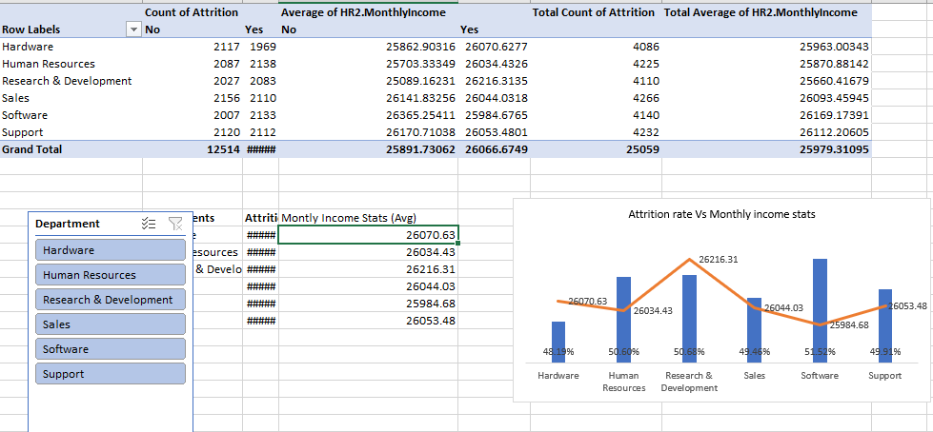
3. Attrition Rate vs Monthly Income Stats
"Attrition Rate vs Monthly Income Stats" compares the rate at which employees leave a company (attrition rate) with their monthly income statistics. It examines whether there's a correlation between employee turnover and income levels. Higher attrition rates coupled with lower monthly incomes might indicate dissatisfaction with compensation, potentially leading to turnover. Conversely, lower attrition rates alongside higher incomes could suggest greater employee satisfaction and retention. This analysis helps organizations understand the impact of compensation on employee retention and overall workforce stability.

Slide 10
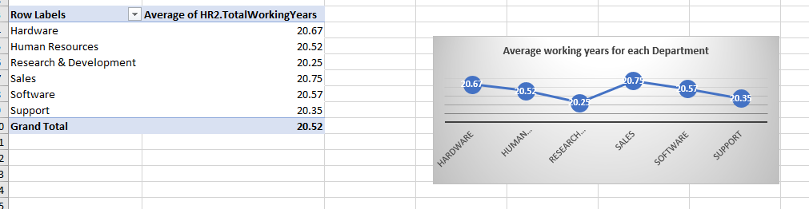
4. Average Working Years for Each Department
"Average Working Years for Each Department" refers to the average length of time employees have been working in their respective departments within a company. This metric provides insight into the level of experience and stability within each department. Departments with higher average working years may have more seasoned employees who bring a wealth of knowledge and expertise to their roles. Conversely, departments with lower average working years may experience more turnover or have a younger workforce. Understanding these averages can help organizations tailor training, retention strategies, and succession planning efforts to meet the unique needs of each department.

Slide 11
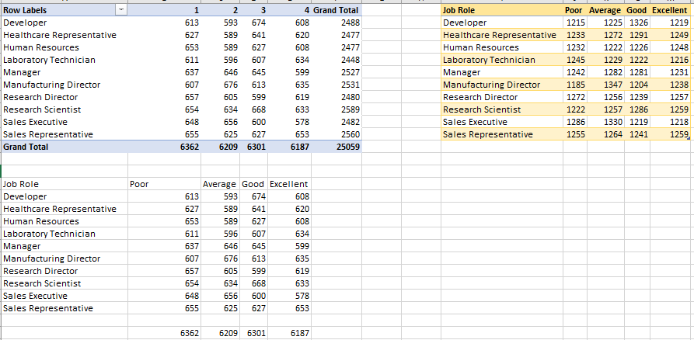
5. Job Role vs Work Life Balance
"Job Role vs Work-Life Balance" examines the relationship between the responsibilities and demands of a particular job and the ability of employees to maintain a healthy balance between work and personal life. Certain job roles may inherently require more time, energy, or flexibility, impacting an individual's ability to achieve work-life balance. Analyzing this relationship helps organizations understand how different job roles affect employee well-being and productivity. It enables employers to implement strategies to promote work-life balance, such as flexible scheduling, remote work options, or workload management initiatives, to enhance employee satisfaction and retention

Slide 12
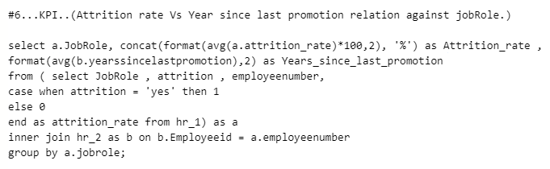
6. Attrition Rate vs Year Since Last Promotion Relation
"Attrition Rate vs Year Since Last Promotion Relation" explores the connection between the rate at which employees leave a company (attrition rate) and the amount of time since they were last promoted. This analysis helps determine if there's a correlation between promotion opportunities and employee retention. For instance, a high attrition rate among employees who haven't been promoted in several years may suggest dissatisfaction with career growth opportunities. Conversely, a lower attrition rate among those recently promoted could indicate that promotions positively impact employee retention. Understanding this relationship can guide organizations in developing promotion strategies that contribute to higher employee engagement, satisfaction, and retention.

Slide 13
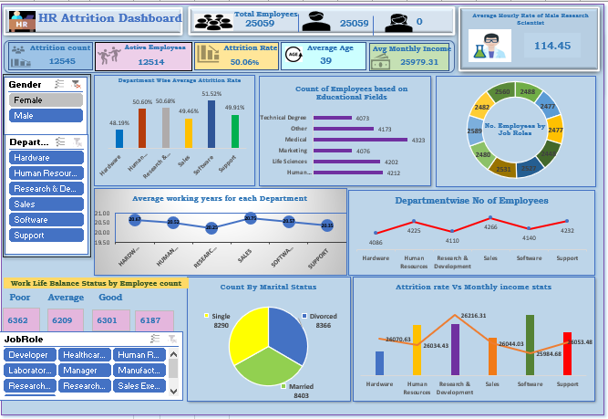
EXCEL DASHBOARD
Excel dashboard" is a visual representation of key data points and metrics designed to provide a concise overview of information for easy analysis and decision-making

Slide 14
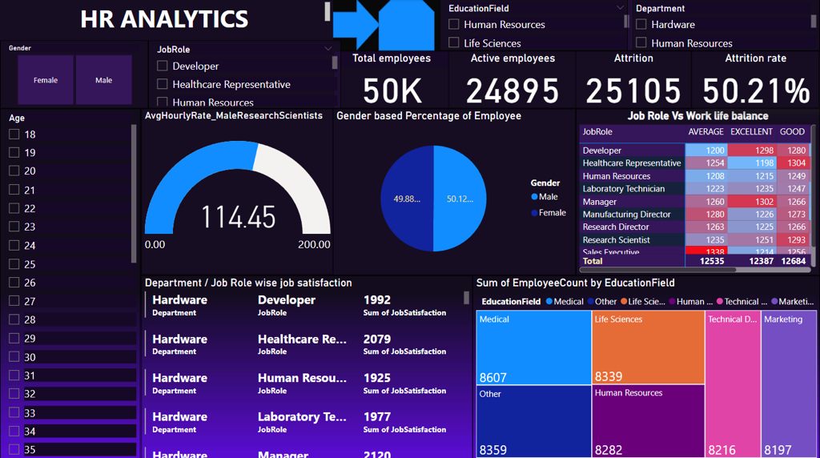
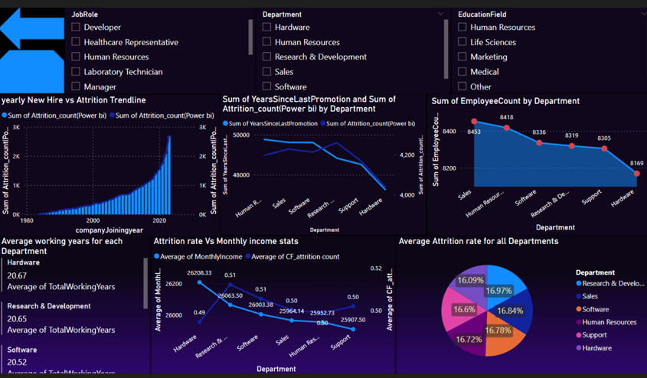
POWER BI DASHBOARD
A Power BI dashboard is a dynamic and interactive platform for visualizing and analyzing data from multiple sources.

Slide 15
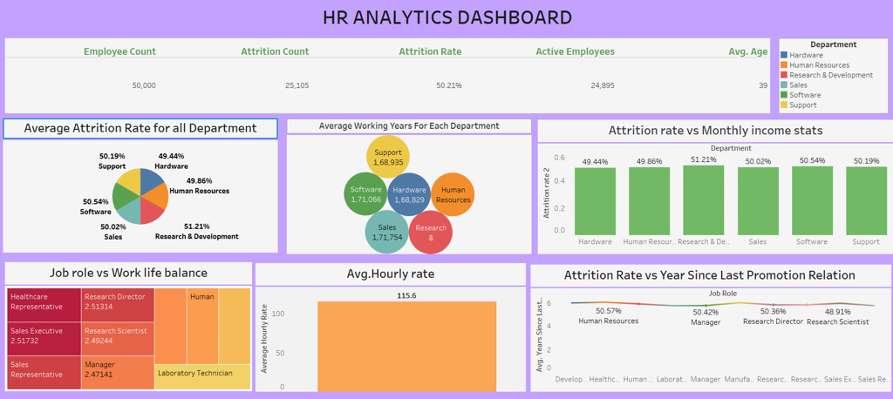
TABLEAU DASHBOARD
A Tableau dashboard serves as a dynamic and visual representation of data, enabling users to gain insights and make informed decisions.

Slide 16
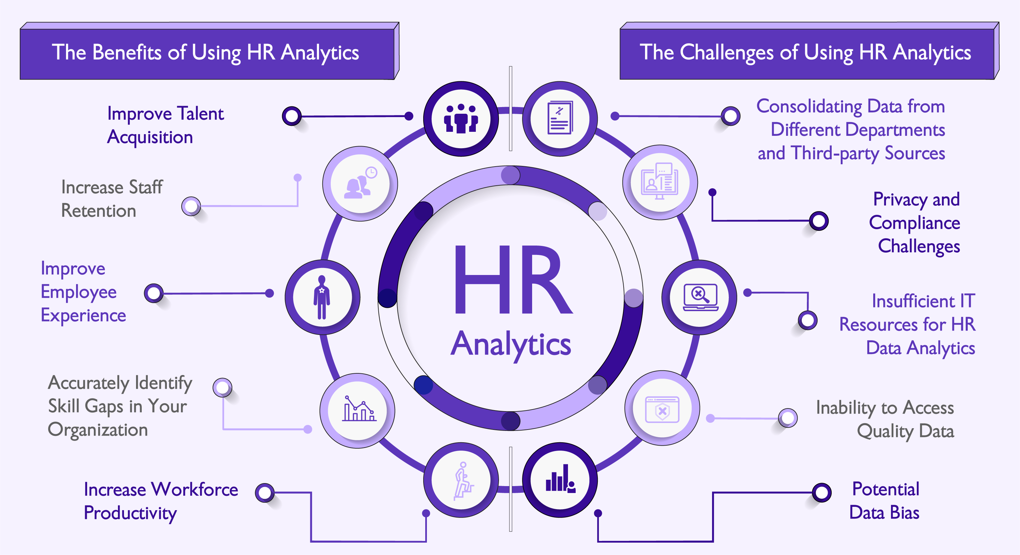
CONCLUSION:
The HR analytics is the process by which the team of human resource through the analytical process works to improves the performance.
When the team of human resource makes use of this process, the business of the company is benefitted at large as it gets larger return on investment.
Deals with the gathering of the employee information to know their efficiency level.
Helps employees by providing the insights and the advice related to the task to help them make relevant decisions

